Slide 1

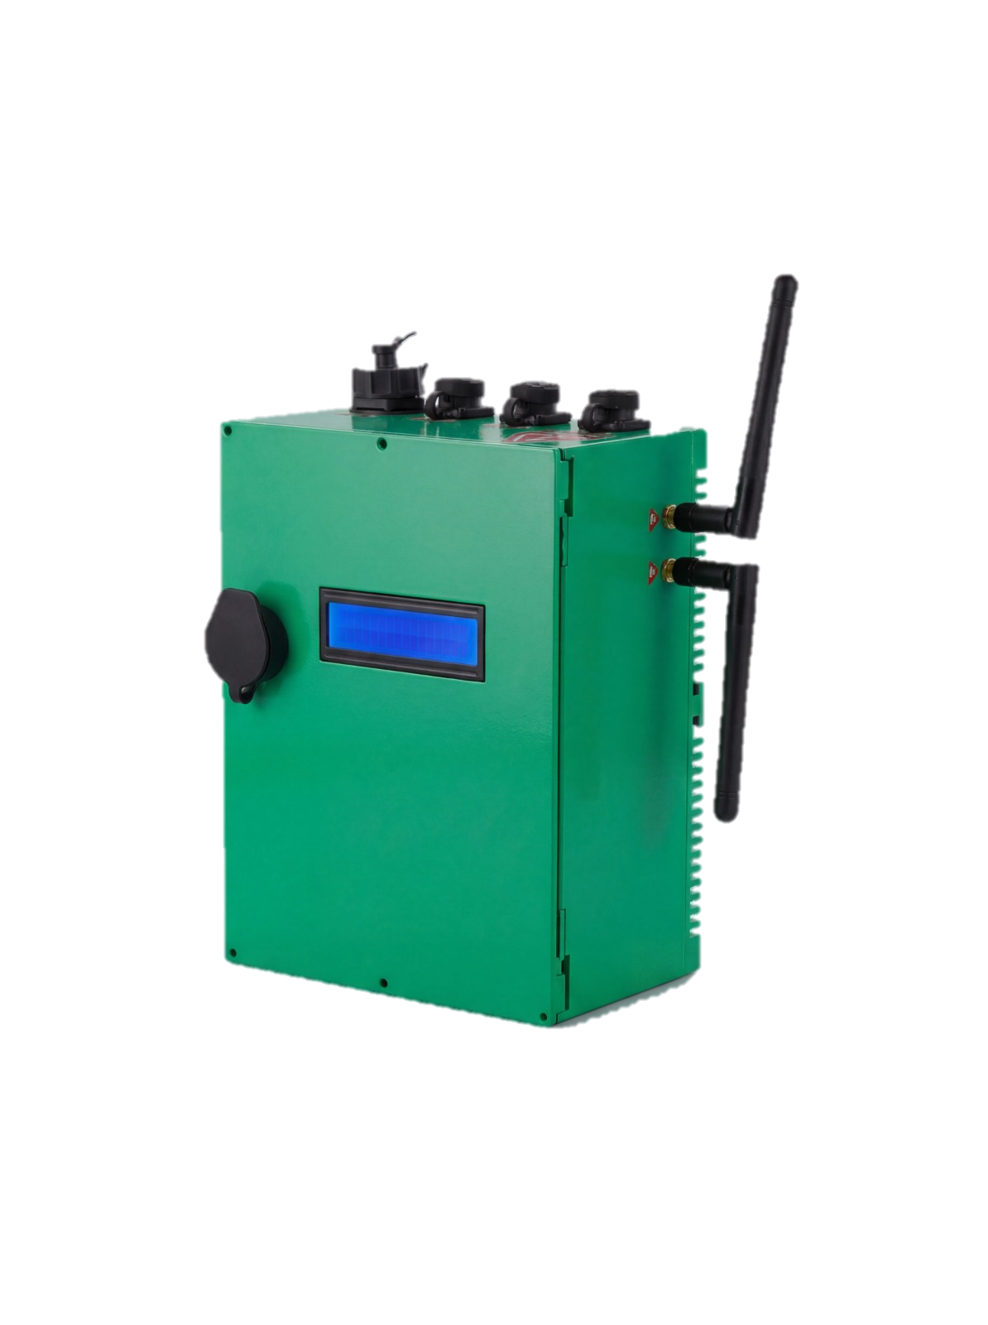
OBSERVER
Environmental Intelligence System
Part of the Observer® Suite
Technology and Solutions
One Platform.
Four Domains.
Complete Picture.
Observer
Contact Us
EIS
Website
www.observer-tech.com
Email
info@observer-tech.com
Air · Water · Soil · Weather
Observer EIS unifies air, water, soil, and weather monitoring into a single AI-powered platform — collecting field data, running predictive models, and sending automated control commands back to the field.
Phone
+971 50 566 3553
Air
Water
Soil
Weather
Headquarters
Real-time environmental intelligence
for a sustainable future
Delaware, USA
Branches
Abu Dhabi, UAE | Amman, Jordan
IP65 · BACnet · MQTT · AI-Powered
ISNR Abu Dhabi 2026
Part of the Observer® Integrated Security Ecosystem
\
Unfold to explore full specifications
OBSERVER
EIS
Technology and Solutions
www.observer-tech.com

Slide 2
What is Observer EIS?
Four Domains. One Platform.
Technical Specifications
Environmental Intelligence
Monitoring Platform
What Observer
EIS Measures
Observer’s Edge Device
Connectivity
5G/4G/3G/2G
Observer EIS is an integrated environmental monitoring platform combining 35+ precision sensors across four domains — air quality, water quality, soil & agriculture, and weather & climate — through a single edge device connected to a cloud analytics platform.
The system operates in a closed loop: sensors measure, the edge device aggregates and transmits, and the cloud platform analyzes, alerts, and sends automated control commands back to the field.
Air Quality
Water Quality
I/O & Ports
2-32 configurable I/O, RS485
11 Sensors
11 Sensors
PM1/PM2.5/PM10, CO, NO₂, SO₂
CO₂, O₃, CH₄, H₂S, VOC, O₂, NH₃
Urban stations · industrial emissions
pH, ORP, Conductivity, TDS, Chlorine
Turbidity, Dissolved O₂, Nitrate
Heavy Metals, Algae, Temperature
Protocols
BACnet MSTP/IP, LonWorks, Modbus RTU/IP, MQTT
Power
220V AC + 12V battery (10-24h backup), 50W average
Enclosure
IP54/IP65 standard (IP67 optional), 230×180×81mm
The Cost of Environmental Blind Spots
Weather & Climate
Soil & Agriculture
Display
75×52mm LED — power, connectivity, input status
What you cannot see
costs you most.
6 Sensors
7 Sensors
Temperature, Humidity, Barometric Pressure
Wind Speed & Direction, Rainfall, UV
Predictive modeling · disaster alerts
Soil Moisture, Leaf Wetness
NPK Nutrients, Salinity, Soil pH
Water Flow · Irrigation Control
Sensor Coverage
Air: 11 · Water: 11 · Weather: 6 · Soil: 7
Regulatory fines, public health risk, 20-40% agricultural crop losses, and infrastructure damage — all direct consequences of missing real-time environmental data. Observer turns reactive crisis response into proactive environmental management.
Data Storage
Local + encrypted cloud; on-premise or hosted
AI Features
Anomaly detection, predictive analytics, data assistant
Why Observer EIS? — Real-world impact across environment & society
Warranty
2 Years comprehensive
35+
190+
Precision sensors across 4 domains
Countries tightening compliance laws
Go Green Initiative — Promotes greenery and sustainability programs by providing real-time environmental baselines and compliance evidence for green policy initiatives.
Reduce Climate Change — Tracks emission trends and climate indicators to support carbon reduction targets and enable proactive early intervention strategies globally.
Multi-Domain Data Collection — Continuously collects quality data on air, soil, water, and weather — building a unified, real-time environmental intelligence picture across all sites.
Environmental Heat Maps — Generates geospatial heat maps for pollution hotspots, soil stress zones, and urban heat islands — visualizing environmental risk at scale.
Target Sectors
Smart Cities & Gov.
IP65
AI
Industrial & Oil/Gas
Public Health
Edge device environmental protection
Predictive analytics & closed-loop control
Precision Agriculture
Water Utilities
Airports & Ports
Environmental Research
www.observer-tech.com · info@observer-tech.com
How It Works
www.observer-tech.com · info@observer-tech.com
Field Sensors → Edge Device → Encrypted Transmission → AI Analytics → Action & Control

