Slide 1
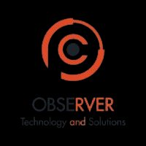
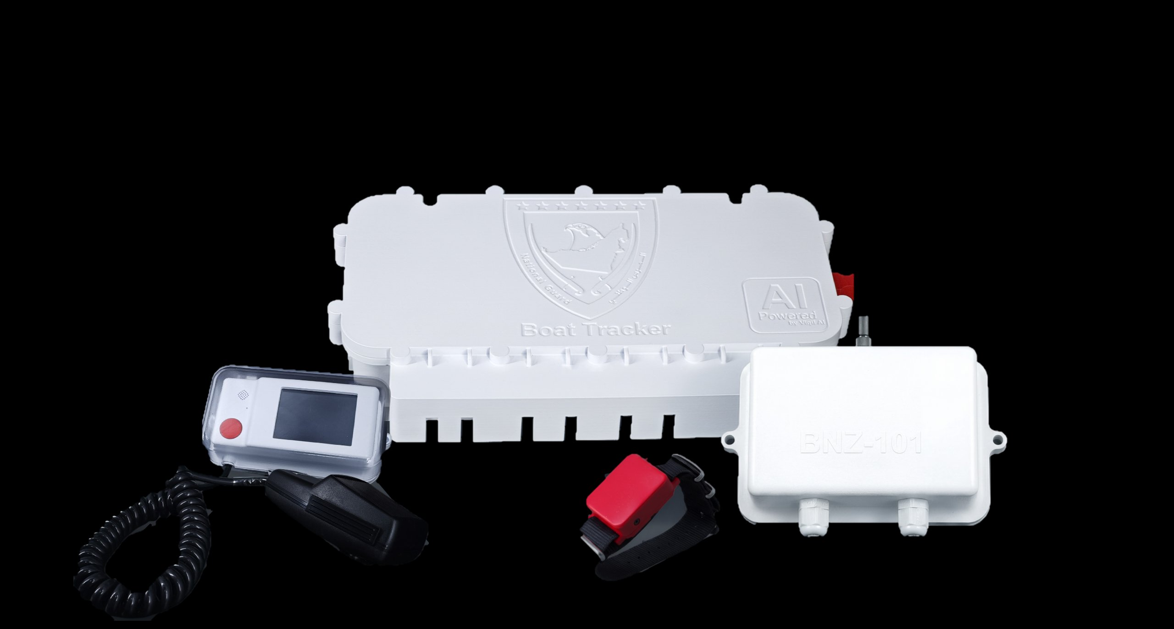
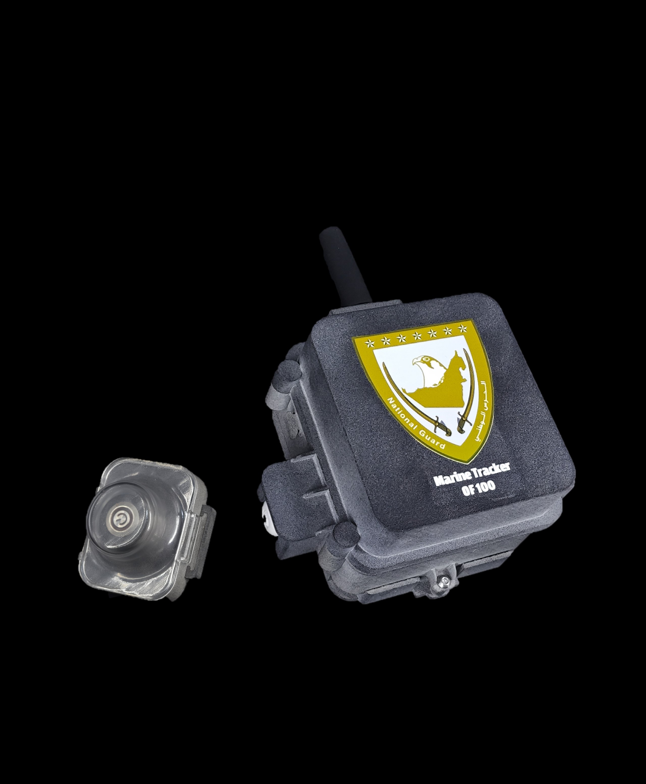
OBSERVER
Fleet, Vessel & Watercraft Tracking and Monitoring
Part of the Observer® Suite
Technology and Solutions
Beyond Tracking.
Awareness. Safety.
Control.
Observer
Contact Us
AVL
Website
www.observer-tech.com
Email
info@observer-tech.com
Tracking and Monitoring Platform · Boat/Yacht Tracker · Jet Ski Tracker
Observer AVL is the software platform that transforms GPS and sensor data from any tracking device into a unified operational picture with live video, intelligent alerts, and incident management.
Phone
True operational awareness on land and at sea
+971 50 566 3553
Headquarters
Delaware, USA
TETRA · IP68 · UL Certified · AI-Powered
Branches
Part of the Observer® Integrated Security Ecosystem
Abu Dhabi, UAE | Amman, Jordan
ISNR Abu Dhabi 2026
Unfold to explore full specifications
OBSERVER
AVL
Technology and Solutions
www.observer-tech.com

Slide 2
What is Observer AVL?
Three Products. One Ecosystem.
Technical Specifications
Automatic Vehicle &
Fleet Location System
Marine Tracking
Unified
All Three Products
Type
AVL: Software platform
BNZ: Hardware (4-component system)
Jet Ski: Single-unit hardware device with emergency button
Observer's AVL system transforms raw GPS coordinates into a unified operational picture combining live locations, video feeds, sensor alerts, and field reports — all in one interface accessible to field teams and command centers.
The platform simultaneously tracks 70,000+ units on a single map and operates online, offline, or on private intranet — making it ideal for military, government, port, and coastal operations.
Network
TETRA/LTE
Observer AVL — Software Platform
Live tracking of 70,000+ units. Integrates live video (CCTV, body-cam, drone). Operates over cellular, digital radio (TETRA/DMR), Wi-Fi, or private tactical networks. AI anomaly detection and data assistant. Supports full offline/intranet operation for military and classified deployments. TWISP certified.
AVL: 70,000+ simultaneous
Boat: Full crew + vessel
Jet Ski: Coastal fleet
The operational brain of the ecosystem
Unit Capacity
Battery
Boat: 28 days
Jet Ski: 14 days
AI Features
Anomaly detection, data assistant, operator behavior analysis, user behavior analysis,
The Observer Advantage
Material
ADS Plastic
GPS shows where.
Observer manages the operation.
Boat Tracker (BNZ Series)
Integrated Maritime Safety Platform
IP68
Cutting edge TETRA boat tracking solution. Four-component system: BNZ-100 (Main Board), BNZ-101 (Bracelet Gateway), BNZ-102 (Alarm Panel), BNZ-103 (Crew Bracelets). Fall-overboard detection, SOS, IP68, voice comms.
Waterproofing
Observer goes beyond displaying a location — it integrates live video, intelligent alerts, detailed reports, and AI Analytics into one system that operates over cellular, radio, or private networks.
Warranty
2 Years across all products
Deployment Use Cases
70K+
IP68
Jet Ski Tracker
Military & Defense
Police & Emergency
Compact Watercraft GPS Device
Ports & Harbors
Coast Guard
Fully waterproof single-unit tracker with built-in integrated antennas. TETRA network, smaller profile than standard trackers, designed for hull installation. Ideal for Jet Skis, tourism operators, and coastal patrols.
Units tracked simultaneously
Waterproof rating: bracelets & mic
Marine Tourism Fleets
TETRA
AI
Search & Rescue
+LTE
Anomaly detection & data assistant
Certifications
TWISP
IP68
ISO
www.observer-tech.com · info@observer-tech.com
www.observer-tech.com · info@observer-tech.com
Part of the Observer® Ecosystem

